Slide 1
Jack Spirko
Land Contour
7190 Nine Mile Bridge Rd, Fort Worth, TX 76135
Chris VIncent
cvvincent@gmail.com

Slide 2
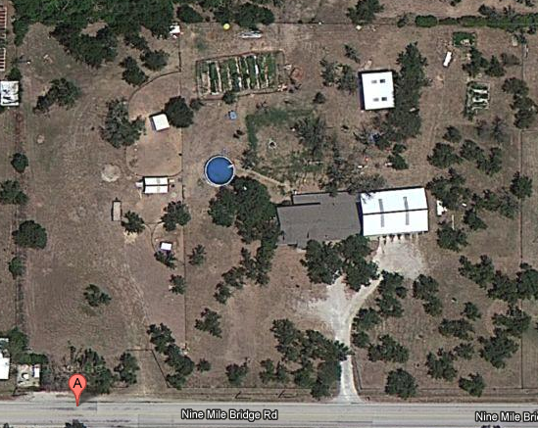
Property

Slide 3
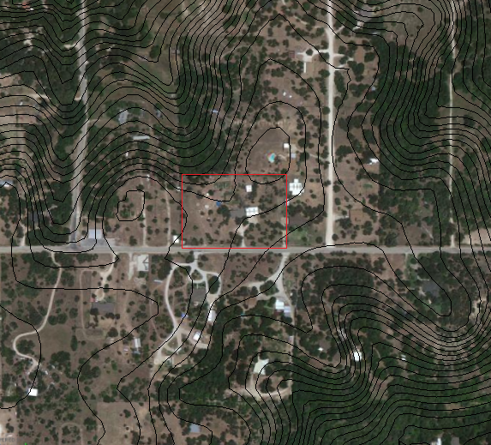
2 ft Contour Lines
Property

Slide 4
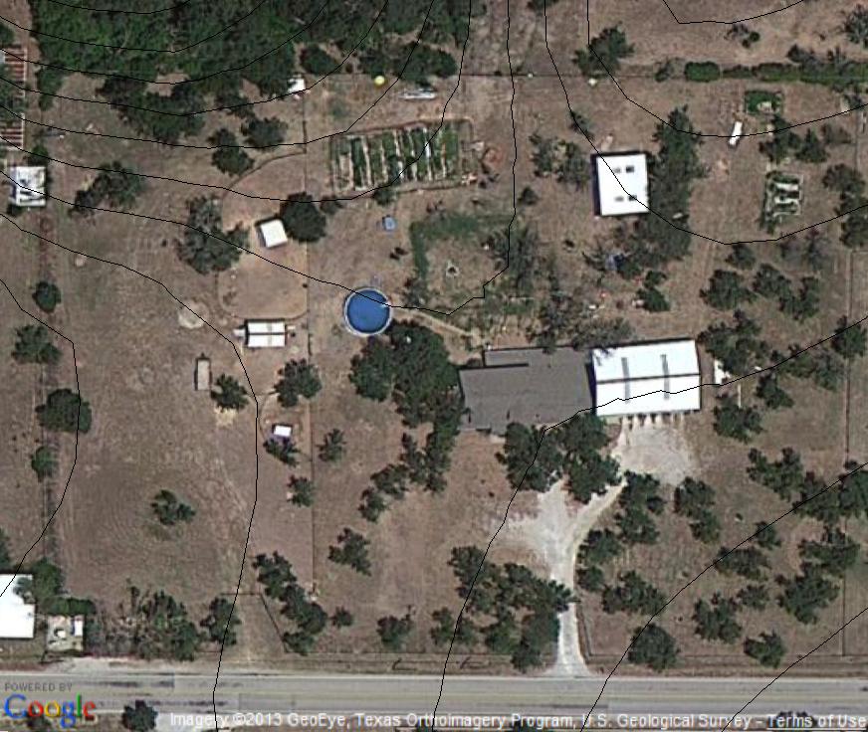
1 ft Contour Lines
High Point

Slide 5
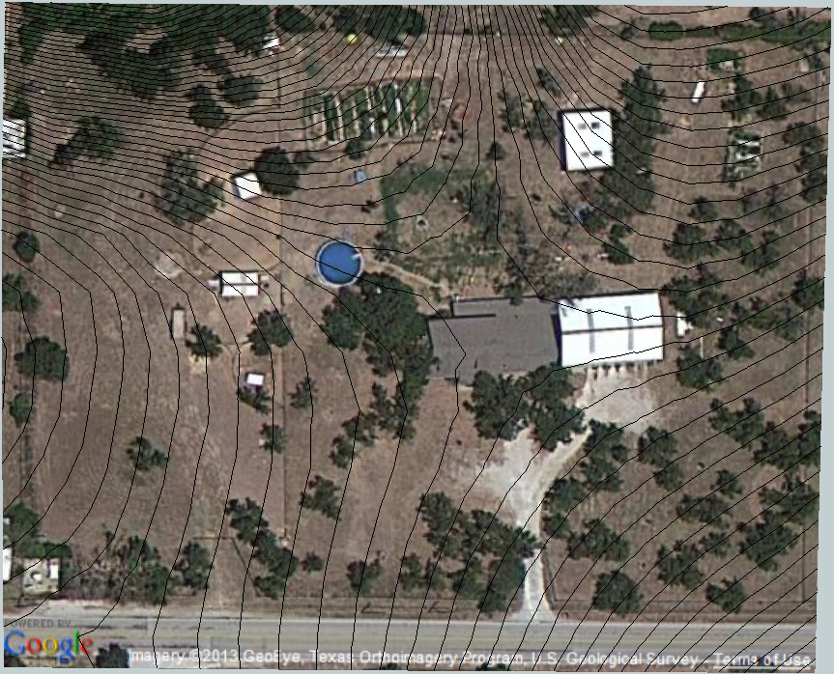
2 inch Contour Lines
High Point

Slide 6
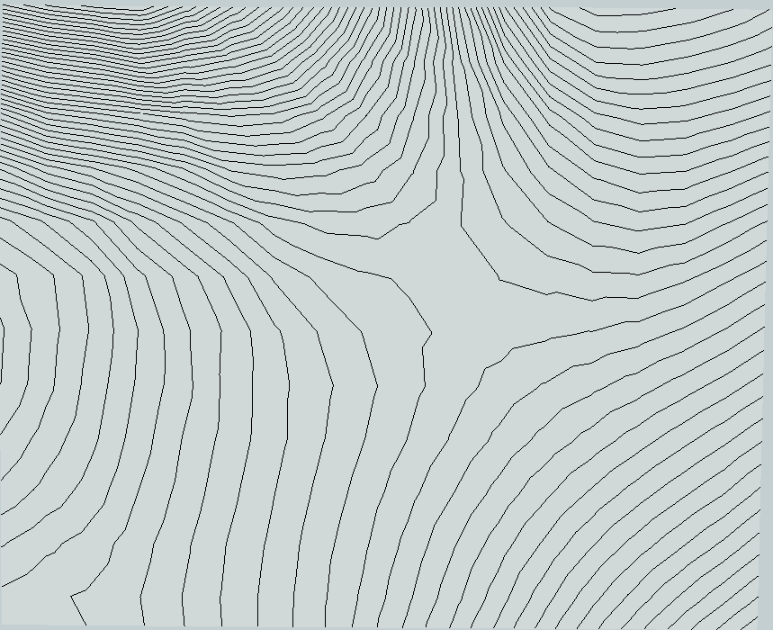
2 inch Contour Lines

Slide 7
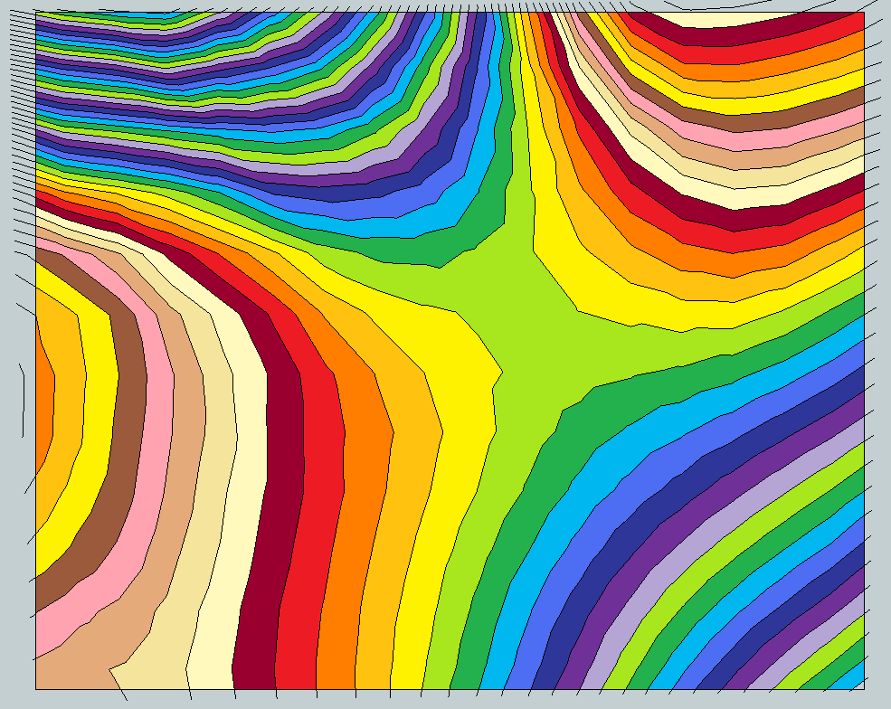
2 inch Contour Lines

