Slide 1


Cut through the crap and build the life you love
#My3Things

Slide 2
Covered in this Module
    Develop Your Personal Vision & Purpose
    Cut Through The Overwhelm With BHAGs
    Build Your Personal Blueprint
    The One Habit To Set Up Great Days

Slide 3
Personal Life Blueprint
Vision
What is “true north” for you/your family? Simple, one sentence, focused.
Purpose
What do you deliver to the world and your most important target community?
BHAGS & Goals
How will you get this done?

Slide 4
Personal Life Plan

Slide 5
Elements for Plan Evaluation
    Will it force choices/trade-offs? Are you willing to execute every element mentioned?
    Clear, simple, and concise—no vague or all-encompassing language?
    Reason for being instantly apparent to everyone?
    Is it sustainable?
    Will it be consistently supported over time?

Slide 6
Vision -- Push and Pull
    Where do you really want to go?
    What will happen if you opt for “a little bit better than today”?
    Are you happy with the status quo?

Slide 7
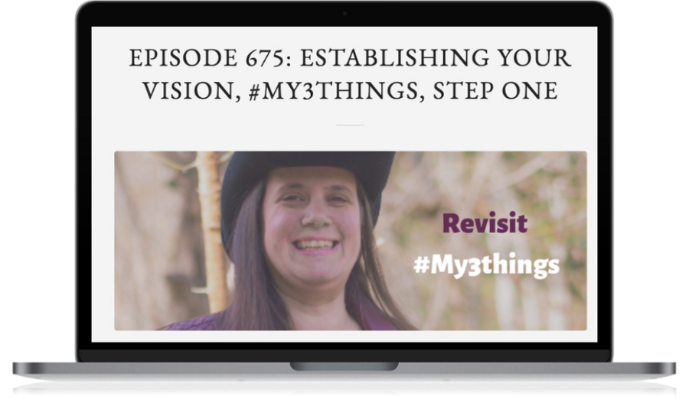


The Questions
LivingFreeinTenenssee.com

Slide 8
Future Vision Development
As a result of your being wildly successful, what has happened?
Examples:
Holler Roast makes it easy to enjoy premium coffee so that DOERS can start their most productive days on the right foot: in the luxury they wish to build.
    The Holler Community provides a supportive place where aspiring agorists and homesteaders can connect, rejuvenate, share best practices and prosper together in freedom

Slide 9
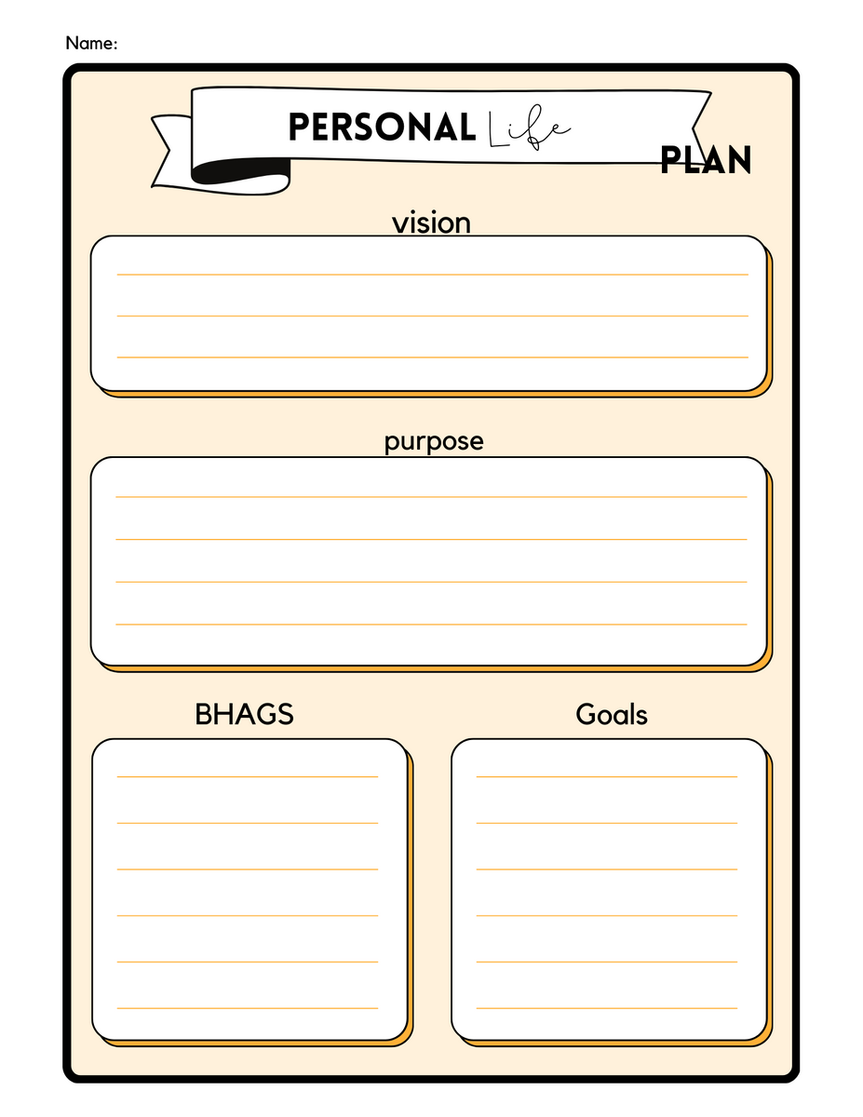
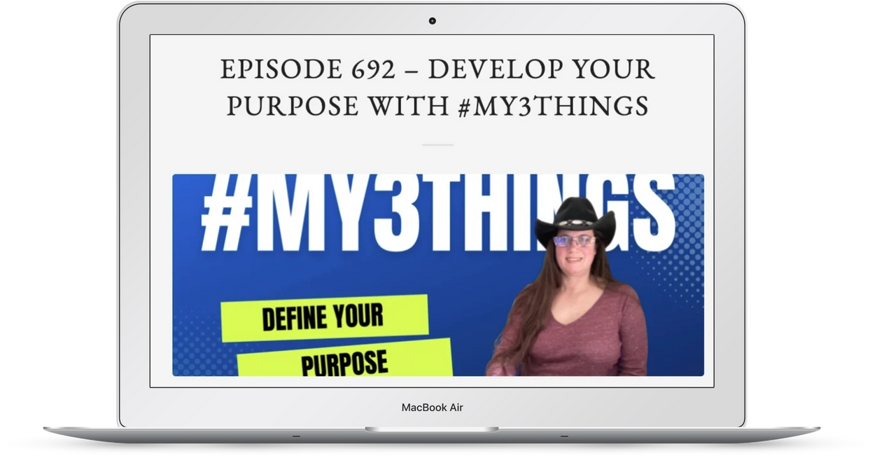
Purpose - So what?
LivingFreeinTenenssee.com

Slide 10
Purpose
Why do you exist in the world?
What unique purpose do you serve?
    Example Purpose:
Holler Roast Coffee delivers a premium coffee experience so that our customers can spend a little to start each day in luxury.

Slide 11
BHAGS & Goals

Slide 12
Intentions and Strategies
  Complete a SWOT Analysis (You and other key players/family)
  Prioritize what must be addressed for your success – up to three things
  Build BHAGS on your priorities
  Set big-picture GOALS to support your intentions over the next 18-24 months

Slide 13
SWOT Analysis
    Strengths:
      Internally, what do we have that helps toward our vision
    Weaknesses:
      Internally, what holds us back from the vision?
    Opportunities:
      Externally, what things outside our group can help us toward our vision?
    Threats:
      Externally, what external things could hurt us most?

Slide 14
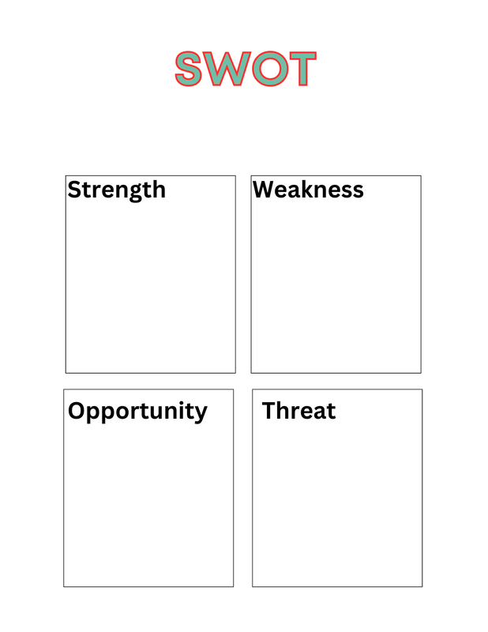
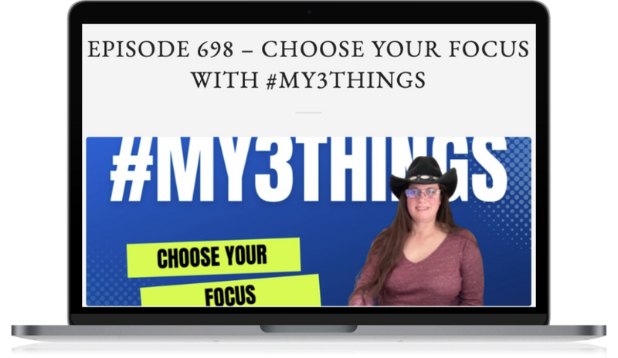
Find Your Priority
LivingFreeinTenenssee.com

Slide 15
BHAG + Goal Example
BHAG: Attract enough ongoing customers so that we can predictably manage our production and farm-sourced products.
  Goals:
  100 monthly subscribers at an average of 4 pounds per subscription.
  4 premium coffee blends for Amazon.com
  1-2 private label contracts

Slide 16
Single Page Blueprint

Slide 17

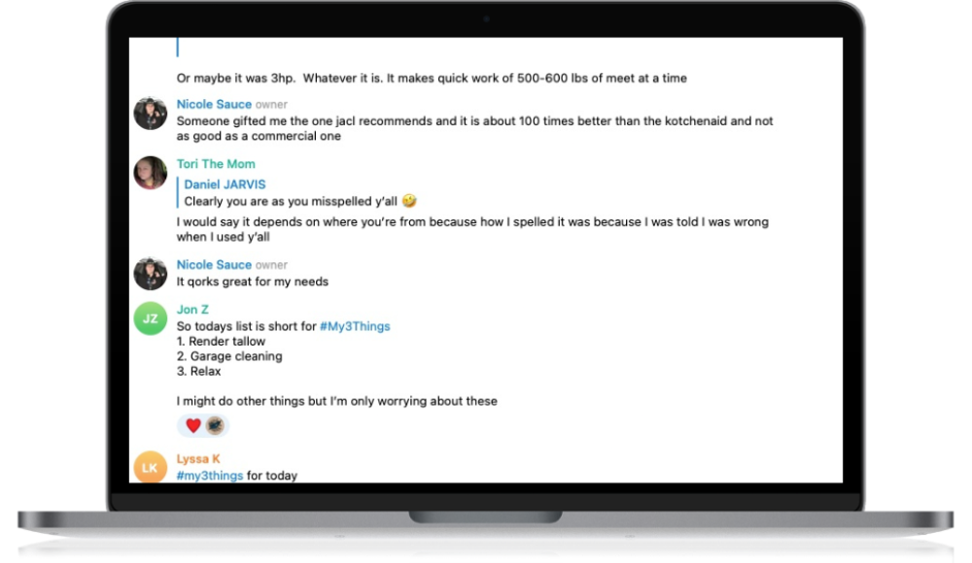
Secret to a Great Day
#My3Things
T.Me/LFTNGroup

Slide 18
Thank you - Let's Connect!
  T.Me/LFTNGroup
  LivingFreeinTennessee.com
  Join The Mastermind Group

