Slide 1

Food Security is the First Security?
Presented by Jack Spirko
The Greater Reset 4
All Resources will be at thesurvivalpodcast.com/greater4

Slide 2
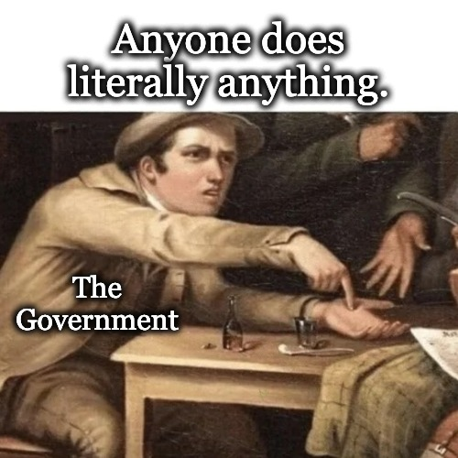
Remember Why We are Here Together

Slide 3
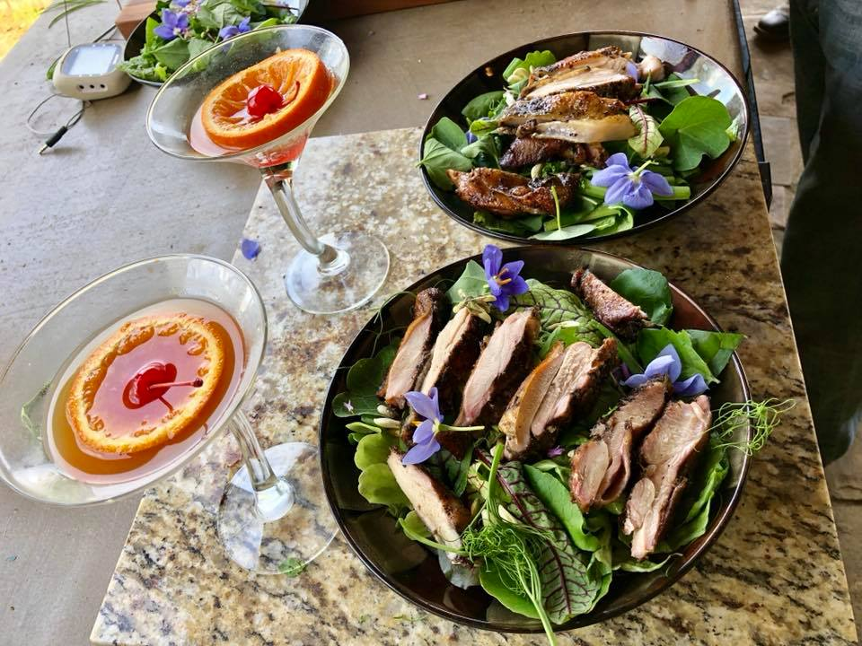
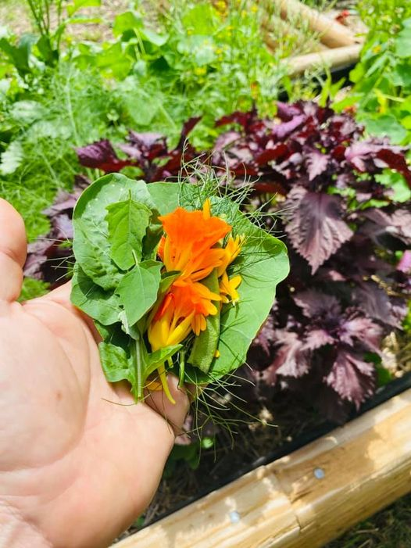
Eating Really Great

Slide 4
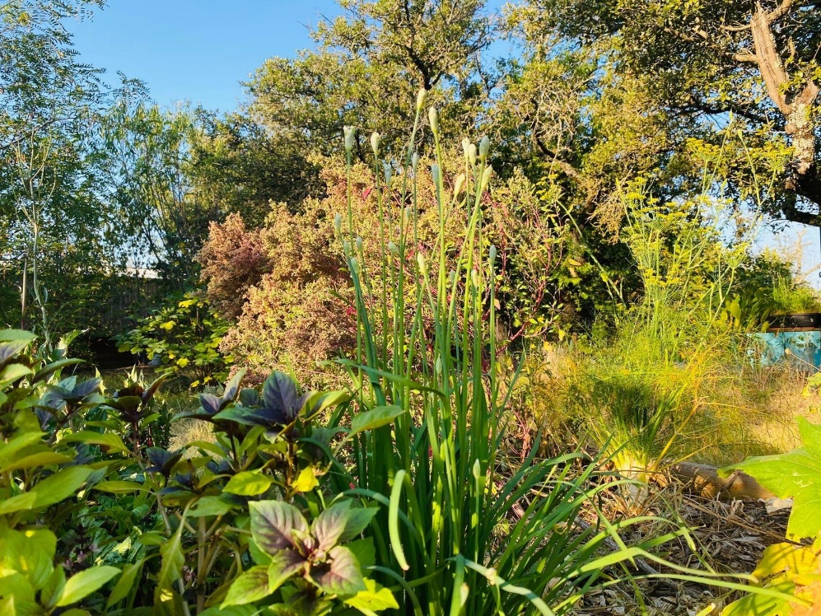
Why I am Doing this Topic
Our #1 Export is Top Soil
Declining Fertility
Declining Biodiversity
Declining Health
12 to 1 Energy Ratio
No Excuse for Any of It!

Slide 5
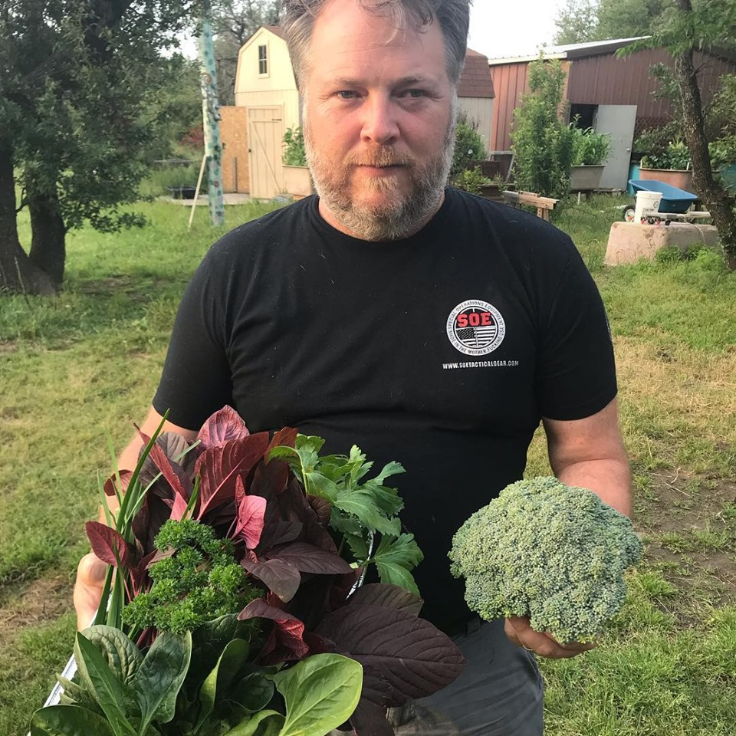
The First Security is Food Security
What We Will Cover Today
  Calorie & Nutrition Crops
  Small Livestock
  Fertility
  Meat Trigger Warning

Slide 6
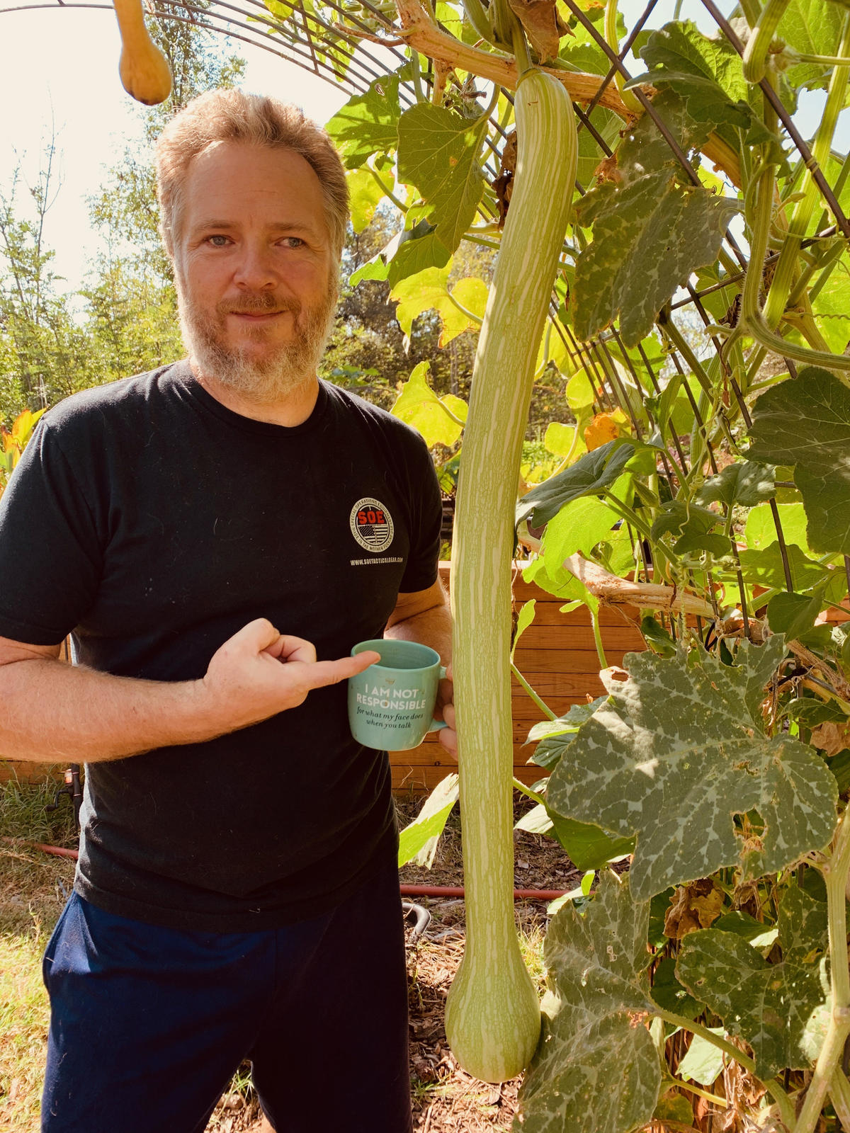
Calorie Crops – Southern Climates
Squash (c. moschata)
Sweet Potato (purple Japanese)
Jerusalem Artichokes (any)
Beans (shelling)
Turnip/Beets (winter crop)
Winter Peas (blaze winter)
Cow Pea (any)

Slide 7
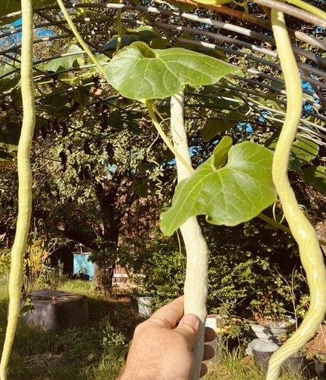
Other Plants I Grow
Python Snake Bean
Beans (Asian Long)
Cucumber (Asian)
Fennel (Florence)
Peppers
Tomatoes (Cherries do best in TX)
Egg Plant (Ping Tung)
Herbs & Greens (all of em)

Slide 8
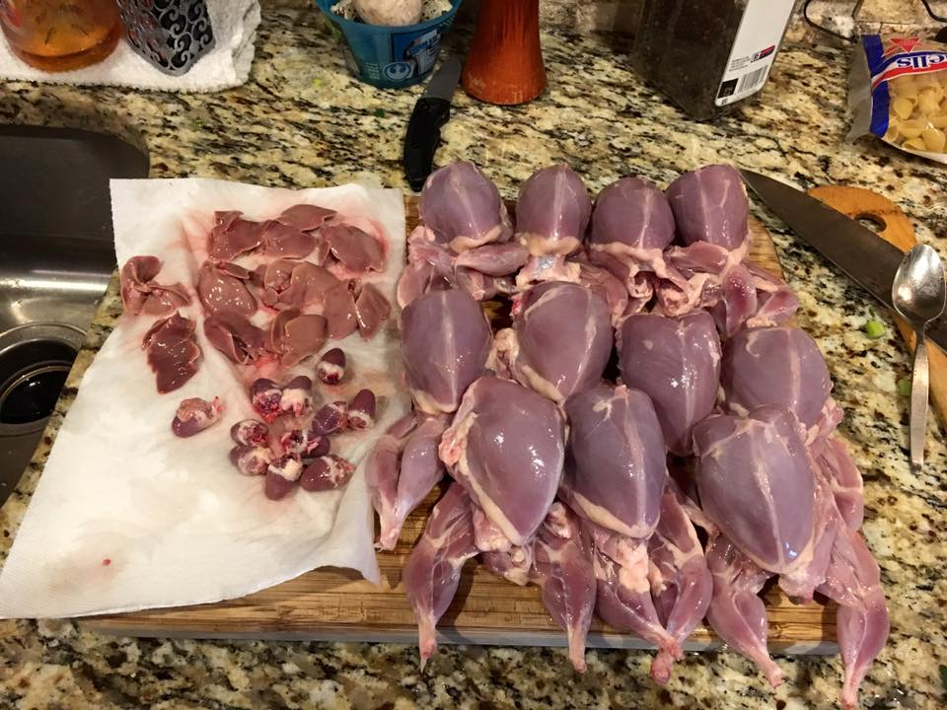
“Small” Livestock
Quail
Chickens (Bresse)
Ducks
Muscovy
Rabbits
Sheep

Slide 9
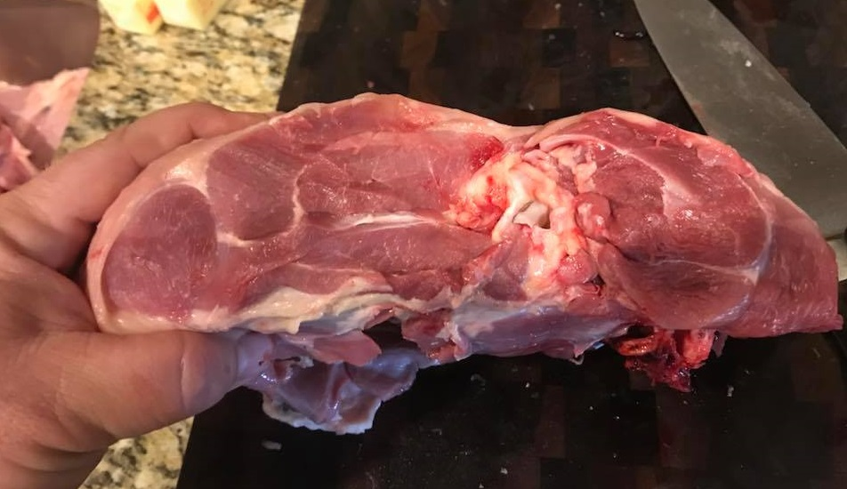
What Do You Think This Is?

Slide 10
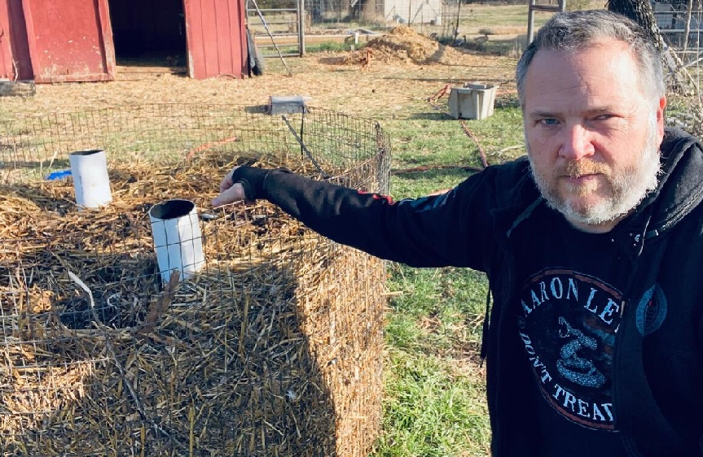
Fertility
Build Fertility
Hold Fertility
Increase Fertility
My Compost
Biochar
Terra Preta
Silvopasture
Grazing Systems
Tactics vs. Techniques

Slide 11
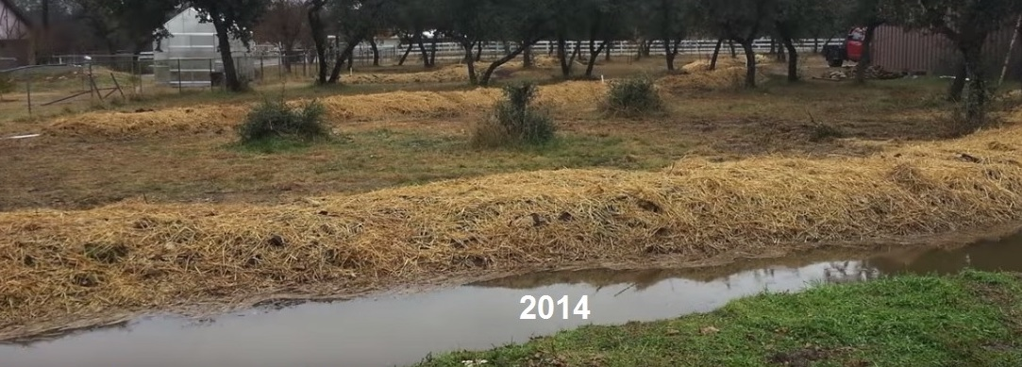
Find Your Heroes and Do Something

Slide 12
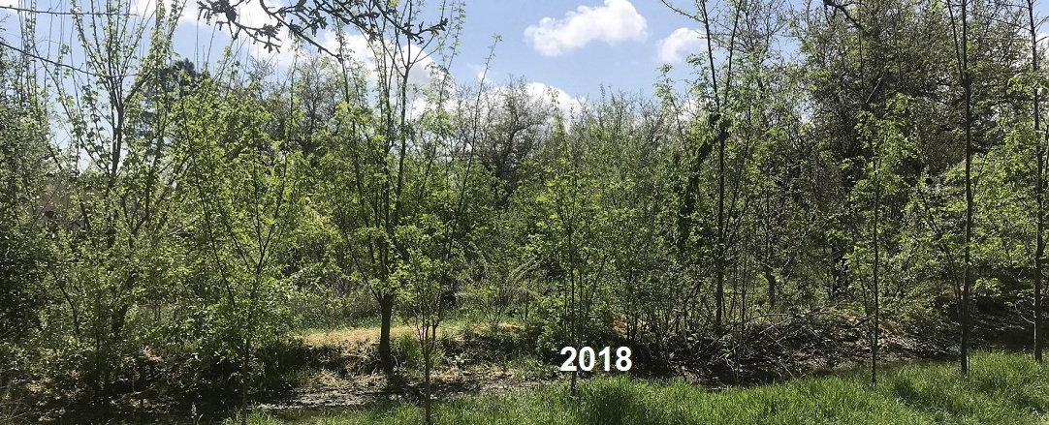
Find Your Heroes and Do Something

Slide 13
Learn More and Connect
Everything you need to connect with me and expand on this presentation including a recording of it, is at
TheSurvivalPodcast.com/greater4

