Slide 1

12 Tenets of a Modern Survival Lifestyle?
Presented by Jack Spirko
All Resources will be at thesurvivalpodcast.com/woods

Slide 2
What it Most Likely To Happen To You – Honestly!
A total collapse of the economy leading to a Road Warrior society
A global pandemic leading to the death of 50% of the population
One some date the world will end because some person said so
We will use up all the oil and that will cause a total collapse
A giant comet will hit the planet ending all life as we know it
And anything else Hollywood has made a movie about

Slide 3
Big Disasters We Have Seen Happen Recently
If you have seen it once you will probably see it again.
Forest Fires
Earthquakes
Hurricanes
Riots
Terrorist Attacks
Ice Storms
“Moderate” Pandemics
Black Outs
Fuel Shortages
Tsunamis
Nuclear power accidents
Flooding
Economic Recessions
Coordinated Attacks
Hazardous Material Release
Droughts
Rapid Inflation
Volcanic Activity
Warfare
Genocide/Ethnic Cleansing
The Lone Gunman
Landslides

Slide 4
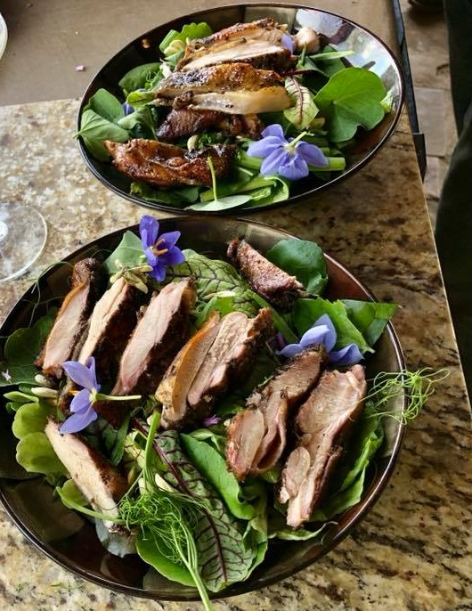
Modern Survivalism Tenet One
Everything You Do Should Improve Your Position in Life Even If Nothing Ever Goes Wrong
  Consider these common preps
    Storing food
    Paying off debt
    Installing alternative energy
    Owning gold and silver
    Growing a garden

Slide 5
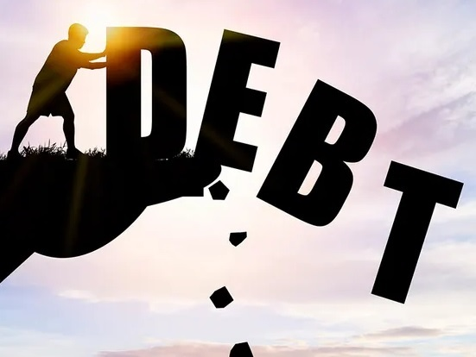
Modern Survivalism Tenet Two
Debt is financial cancer! Minimize it, pay it off early and stay away from consumer debt.
The similarities of cancer & debt
How personal debt enslaves people
The real cost of debt is time (dash)
How to get out while ignoring BS
No one ever resents debt freedom!

Slide 6
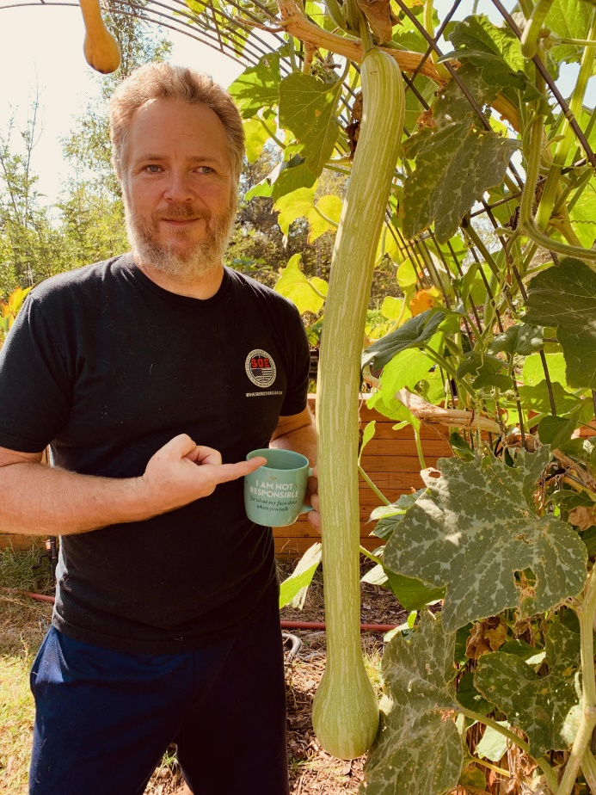
Modern Survivalism Tenet Three
Become a Producer of Food – Growing Your Own Food is for Everyone, Not Just Eco Hippies.
You need food more than money, gold, guns or electricity
Getting more food is easy, as long as you still have some
Storing any commodity is a finite endeavor
“I have to put food on the table”
Producing includes the production of storable items

Slide 7
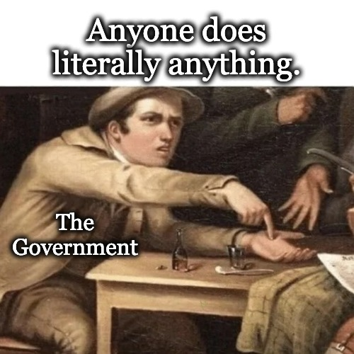
Modern Survivalism Tenet Four
Tax is theft; the best way to combat it is to understand every legal deduction you can take or create.
Solutions
  Good accounting practices
    Focus on the 95%
  Used items & Barter and Trade
  Grey markets and agorism
  Avoid sin taxes
  Reduce income and give to charities

Slide 8
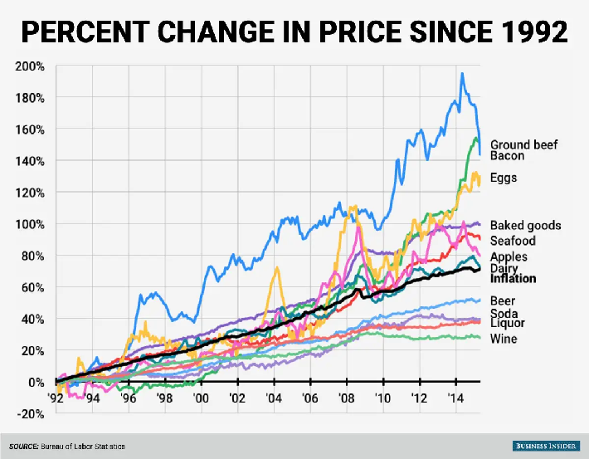
Modern Survivalism Tenet Five
Food stored is an exceptional investment
  2020 – 3.5% ROI
  2021 - 11.8% ROI
  2022 - 11.4% ROI
5 Rules of Food Storage
  Store what you eat
  Opportunity buy
  LTS as Adjuncts
  Become a producer
  Seek a holistic solution

Slide 9
Modern Survivalism Tenet Six
Prepare for disaster based on the most likely threats you face as an individual.
  Probability and the number of people effected have an inverse relationship
    One person looses a job vs. total economic collapse
    Localized riots vs. a global pandemic with a 10% death rate
    An Earthquake vs. global nuclear war
    Truckers strike vs. a new ice age
  Order of Probability
    Individual – Local – Sm Region – Lg Region – National - Global

Slide 10
Modern Survivalism Tenet Seven
Alternative energy is for creating independence not for saving polar bears.
  Focus first on efficiency
  Build a simple back up power system
  Acquire a generator set
  Add small scale solar or wind to the back up system
  Build a passive solar heating system (such as solar hot water)
  Add a more powerful generator (2 is 1, 1 is none)
  Consider adding a large scale solar, wind or combination system

Slide 11
Modern Survivalism Tenet Eight
Owning land is true wealth, owning productive land is the primary means of creating systemic independence.
  Changing a home into a homestead
    Pay off the mortgage as fast as reasonably possible
    Improve energy efficiency and independence
    Move away from large urban areas (personal choice)
    Incorporate permaculture techniques
    Utilize small livestock, aquaponics, greenhouses, etc
    An acre may be more than enough

Slide 12
Modern Survivalism Tenet Nine
Don’t ignore pragmatic preparations such as insurance, emergency cash funds and long term investing.
  Life, Property, etc. Insurance to meet your asset replacement value
  Include real commodities in your investments (silver/gold/tools/etc.)
  Bitcoin should be part of your investment portfolio
  Don’t not put 100% of saving into “retirement accounts”
  Life establishment funds for children (not “college only” investments)
  Save cash in and out of the banking system
  Have a will and keep it updated

Slide 13
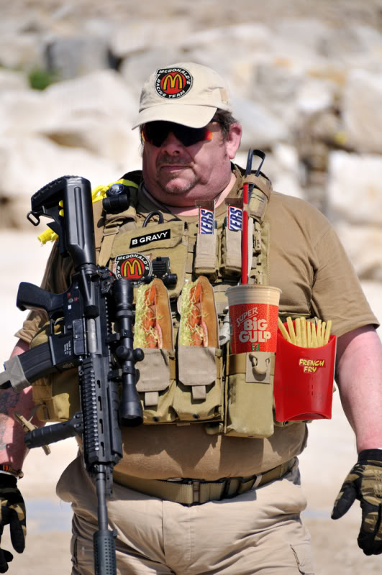
Modern Survivalism Tenet Ten
Have a means of defense, acquire the knowledge and training to use it effectively.
  Rights you don’t exercise are often lost
  Not everyone is your friend
  Develop protocols and procedures and know the damn difference
  My basic recommendations
    Get professional training
    A shotgun, 22 rifle, centerfire rifle & personal defense handgun
    Carry non lethal self defense as well

Slide 14
Modern Survivalism Tenet Eleven
Build a disaster documentation package and keep multiple identical copies for all family members to use.
  The evacuation rule of threes
    3 destinations
    3 routes per destination
    3 rally points per route (with method of communication)
  Everyone you could ever need to contact and all contact information
  All key account and personal ID numbers (simple encryption)
  Contact info for service providers, merchants & support organizations
  Minimum of 3 identical copies

Slide 15
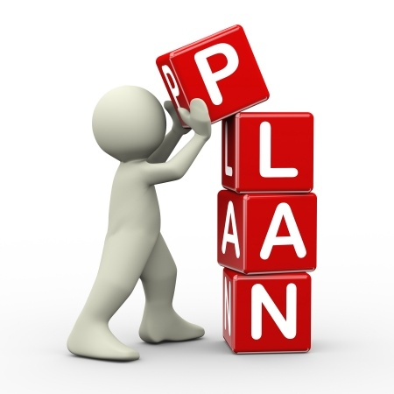
Modern Survivalism Tenet Twelve
Develop and implement your own personal plan
Mindset is more important than what you possess
People are motivated by personal benefit/loss
My plan will not, can not and won’t work for you
The Golden Rule of Survivors – What you do matters!

Slide 16
My Minimum Recommended Steps
  Build a B.O.B. (bug out bag aka 72-hour kit)
  Create a minimum of 30 days of self sufficiency in your home
  Develop your documentation/evacuation package
  Grow something even on an apartment deck
  DO NOT put 100% of your saving in “retirement accounts”!
  Pay attention (situational awareness)
  Develop and follow a debt elimination plan (destroy consumer debt)
  Learn what you can eat that grows wild in your area
  Have a means to purify water other than boiling
  Assemble a blackout kit (lighting, heating, cooling & your freezer)

Slide 17
Learn More and Connect
Everything you need to connect with me and expand on this presentation including a recording of it, is at
TheSurvivalPodcast.com/woods

