Slide 1
Biochar on the Homestead or Small Farm
Presented by Jack Spirko

Slide 2
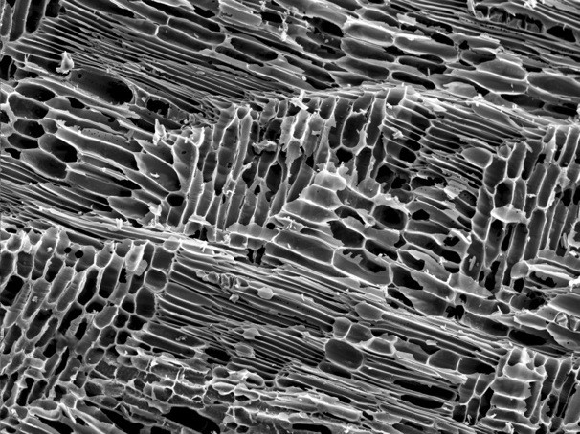
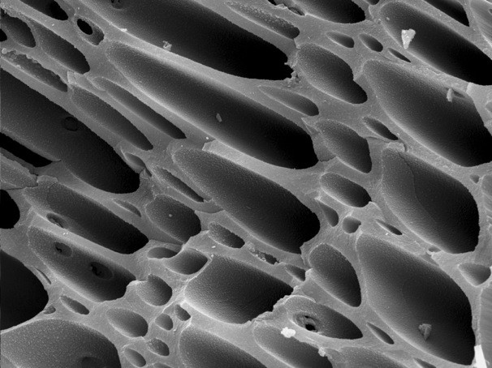
All Biochar is Charcoal but Not all Charcoal is Biochar
“Biochar is to the soil as coral is to the sea”!

Slide 3
What is Biochar vs. Charcoal

Slide 4
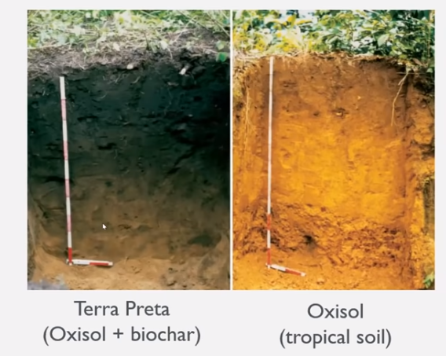
The Most Famous Biochar Use Case
Terra Preta Soils
Developed in Amazonia
Civilization of Millions
Contains..
Human wastes
Pottery shards
Animal bones
Shellfish remains
Remains fertile 500 years+
Seems to “grow back”
Not the only example
Most likely began as an accident
Unique combo of microbes

Slide 5
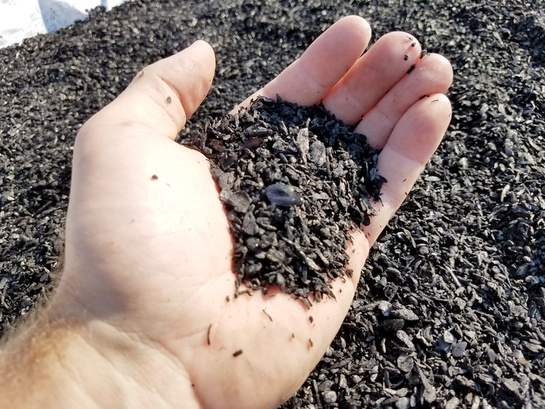
Biochar Has Many Uses Beyond the Soil
Reduce smell and nutrient off gassing in livestock bedding
Improve feed use efficiency in livestock
Bind up human waste in off grid situations
Insulation in alternative building technology
Toxic soil remediation
Aquatic systems filtration
Preventing pesticide runoff in ground water
Lightning potting soil instead of perlite or peat
And of course as a soil amendment

Slide 6
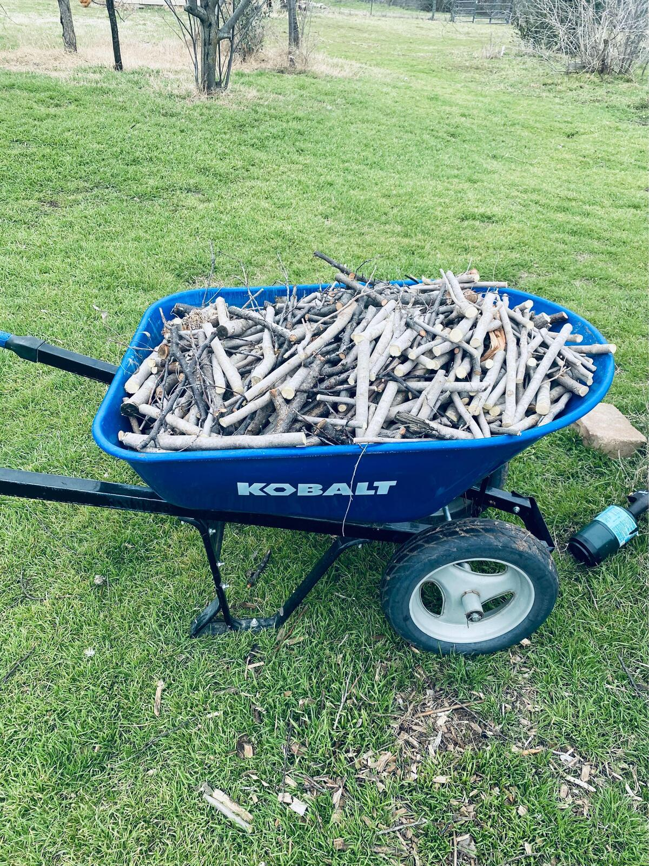
What Makes a Good Feedstock
Tree trimmings/slash
Waste cuttings from saw mills
Wood chips (it depends)
Ag waste like corn cobs/stover
Sunflower stalks and heads
Switch grass
Livestock Manure
Bagasse (sugar cane waste)
Nut Hulls
Wood pellets
Technically anything carbon based

Slide 7
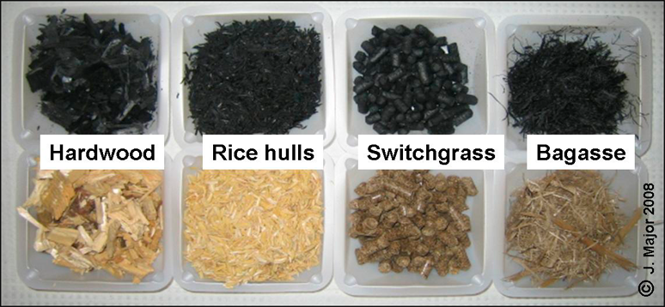
Most Things Other Than Wood are Less than Optimal for Homestead Level Use

Slide 8
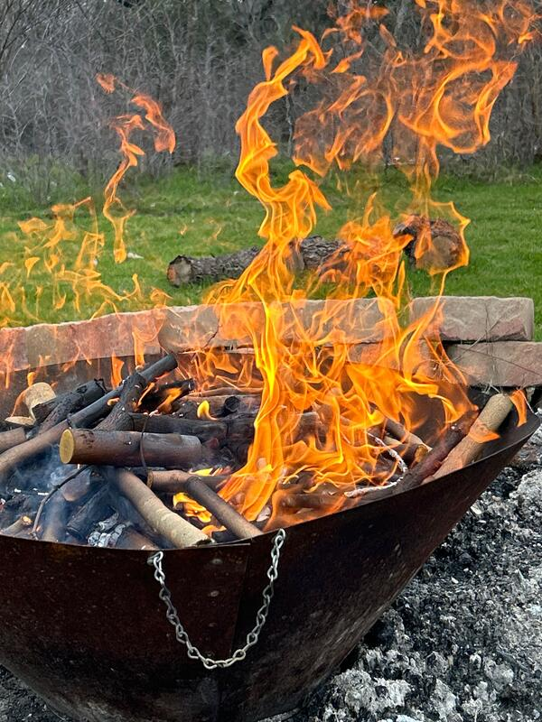
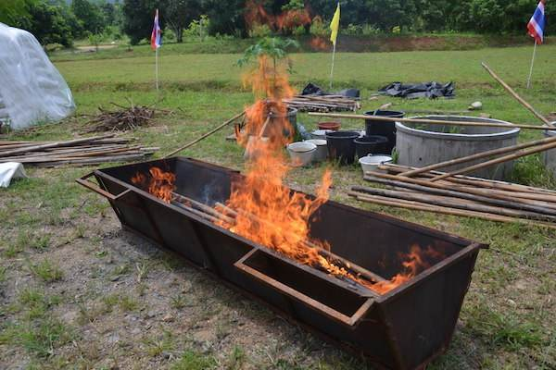
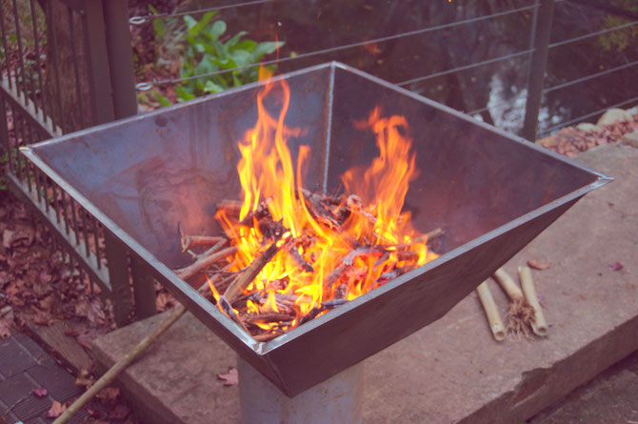
Home Production Methods – Cone/Pyramid & Bin Style Kilns

Slide 9
Home Production Methods – Cone/Pyramid & Bin Style Kilns
Advantages
Super Simple
Makes a good volume fast
Easy to quench (from bottom)
Works well even with fresh cut feed stock
Disadvantages
Requires constant monitoring
Requires constant feeding
Requires sized material
Significant smoke at times

Slide 10
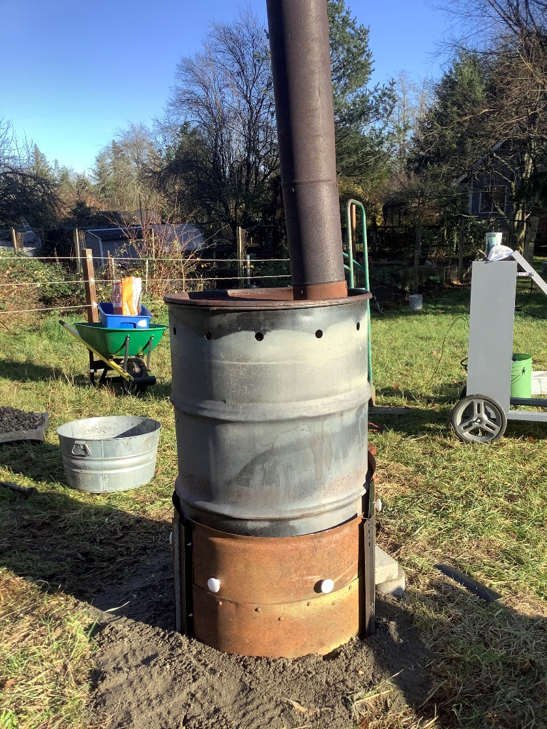
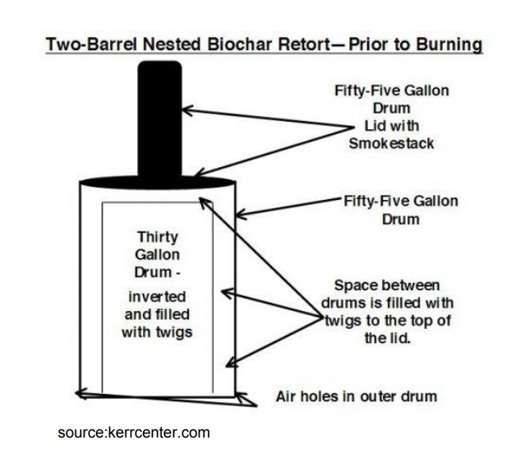
Tin Man Retort

Slide 11
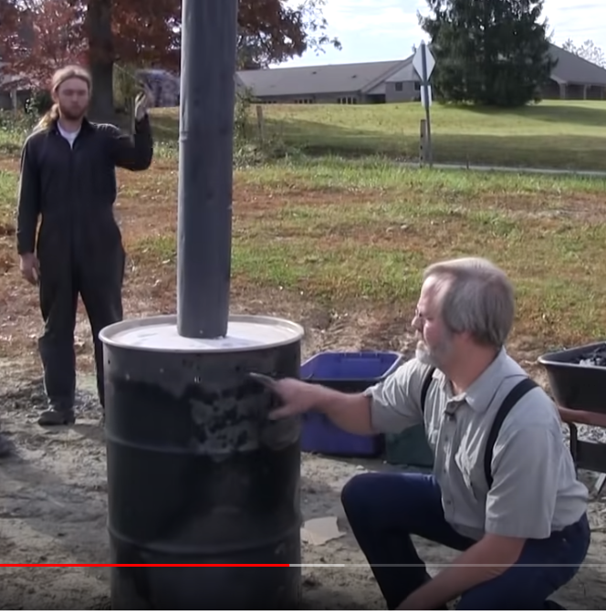
TLUD Kilns – Tin Man Retort
Advantages
Self Regulation – No Cont. Feed
Makes Reasonable Amounts
Enables the use of the heat
Disadvantages
Limited life cycle of drums
Feedstock needs sizing
Doesn’t do well with wood chips
Must be well seasoned feed stock

Slide 12
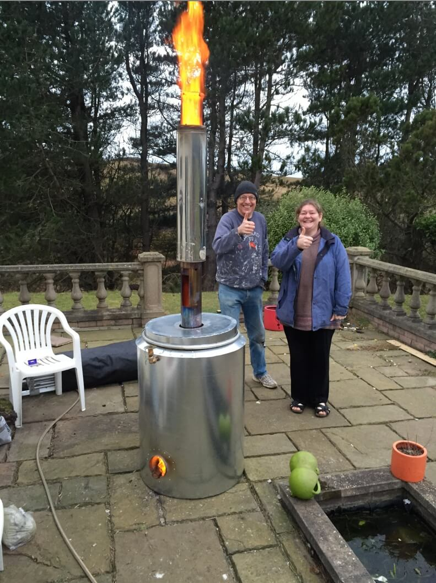
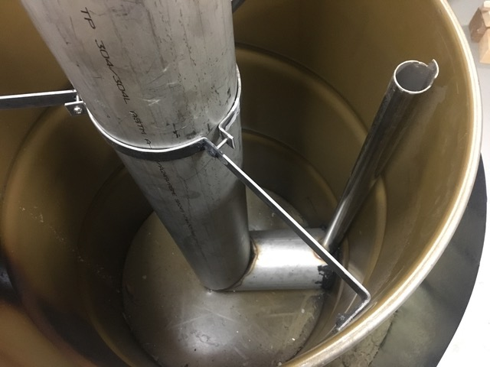
Hookway Retort – Might be the Best I have Seen

Slide 13
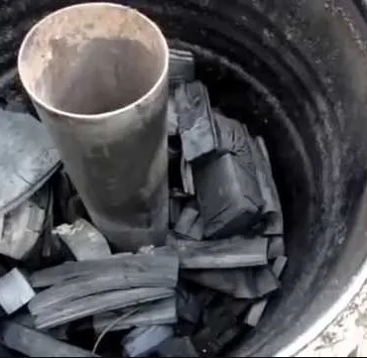
Hookway Retort – May be the Best I have Seen
Advantages
Self Regulation – No Cont. Feed
Makes Efficient Use of Space
Enables the use of the heat
Rocket Stove inside a Retort
Extremely high quality char
Disadvantages
More complex to build
More expensive to build
Feedstock needs sizing
Feedstock needs to be seasoned
Requires feeding for about an hour
More labor to empty

Slide 14
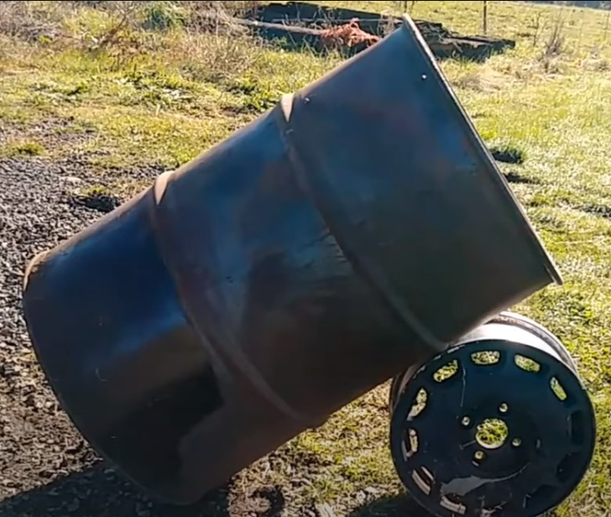
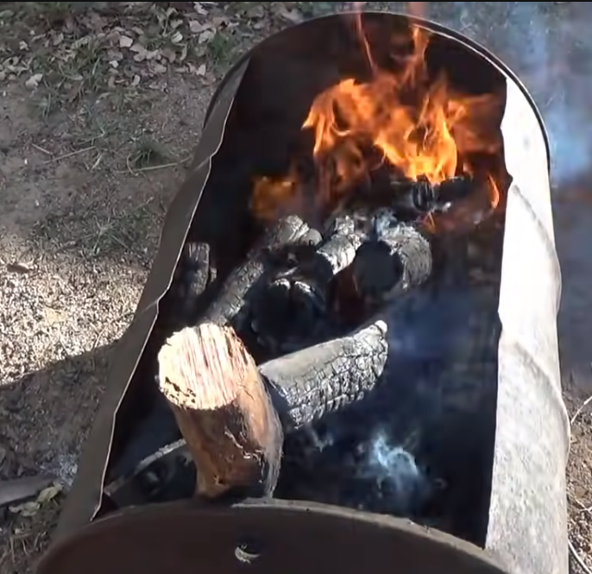
Stupid Simple Methods – Drums etc.
Cheap and Make a Lot of Volume Fast

Slide 15
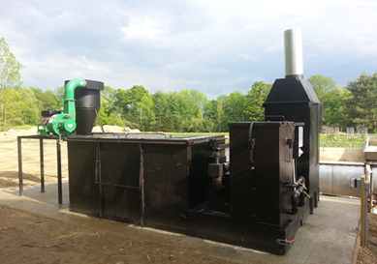
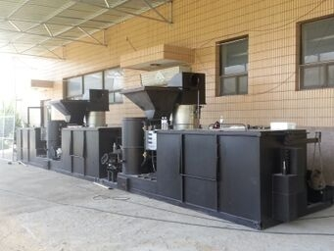
Commercial Scale Kilns
At Large Scale Kilns can…
Make bio char
Heat buildings/greenhouses
Generate electricity
Mine bitcoin
Harvest wood vinegar
Operate on cont. feed systems
Heat ponds (aquaponics)

Slide 16
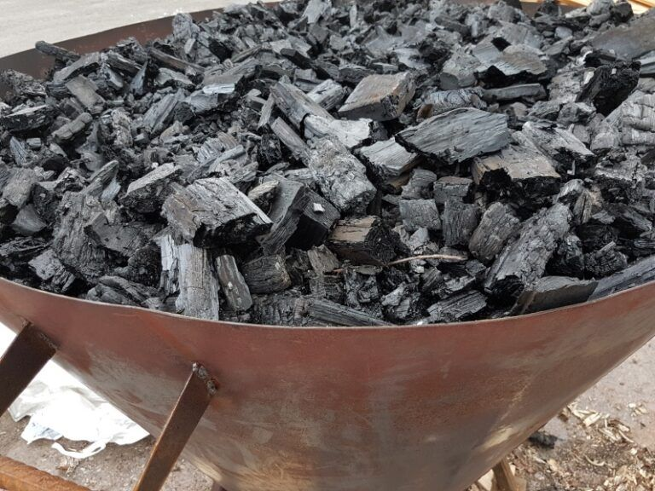
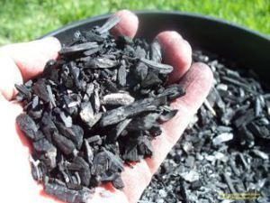
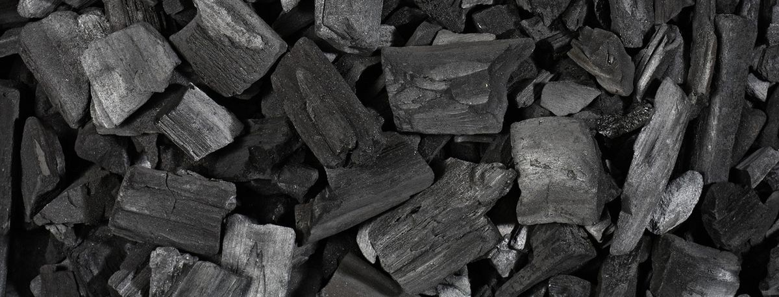
How Do I Know I Made Good Biochar
Low volume of ash
No real flame left (open kilns)
When dry it sounds like glass
Crushes easily
Rinses clean from the hands
Burn was mostly smoke free
Yield is about 30% by dry weight

Slide 17
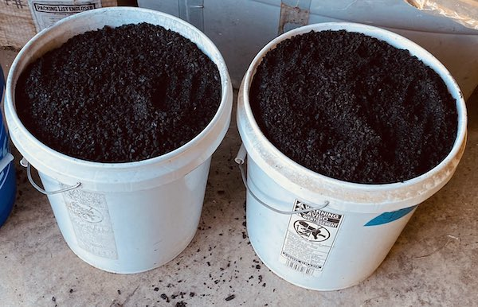
Once Char is Made it must be Crushed
Genal advice is the smaller the better
¼ inch with a variety of sizes
Most at home folks drive over it
A commercial quality leaf vacuum is perfect
I reburn any that don’t crush to size easily

Slide 18
Why Some Say Biochar Doesn’t Work
Biochar must be inoculated before use
It isn’t a fertilizer it is a soil conditioner
Many research projects seemed intentionally flawed
Biochar will work best in living soils
Biochar soils improve with time
What type of biochar matters

Slide 19
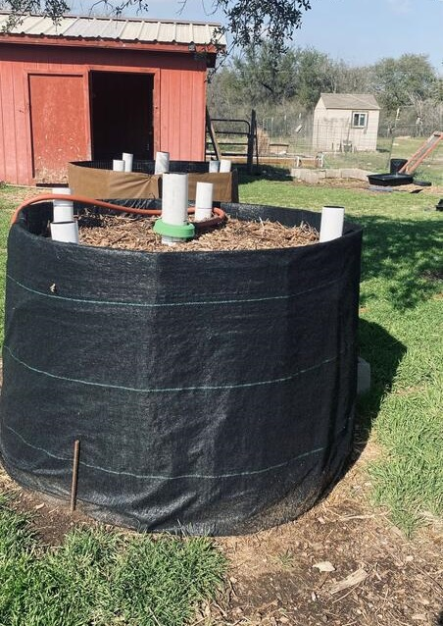
Inoculation – Add it to Something You Already Do.
The first step is to wet the char
Inoculation with compost tea
Inoculation with human urine
Inoculation via the compost process
Part of a compost toilet system
Pass it though livestock
Include it in livestock bedding
Add it to completed compost
Purchase it pre inoculated
Use it in worm bins

Slide 20
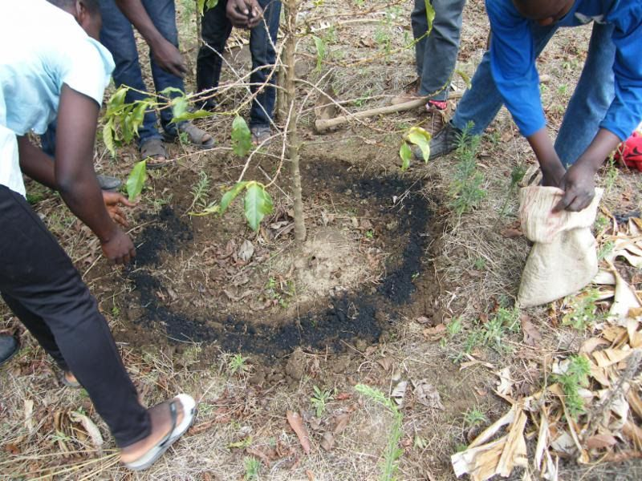
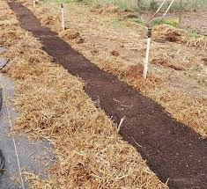
Getting Biochar into Your Soil
Apply with seasonal compost
Spot apply urine biochar
Use it in seed starting mix
Apply it in trenches in your garden
“Moat” around trees
Till in – first time only
Add it when growing a cover crop
Broad fork it
Setting out transplants

Slide 21
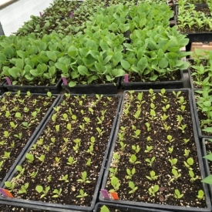
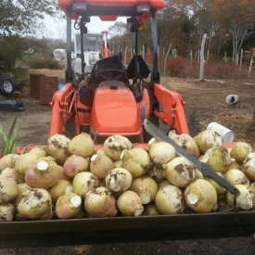
Once It’s In Soil What Does it Do
May slightly raise PH
Provides a home for microbes
Becomes a reserve for nutrients
Holds 7X its weight in water
Increases Cation Exchange (CEC)
Increases Anion Exchange (AEC)
Lightens tilth
Increases carbon content
Binds up toxins (adsorb no absorb)
Promotes seed germination

Slide 22
Resources Available at TheSurvivalPodcast.com/biochar
YouTube Videos
Living Web Farms Full Workshops
BioChar Inoculation
Biochar What, Why & How
Farm Scale Biochar
Hookway Retort in Action
8 Low Cost Ways to make Biochar
Biochar with a Simple Drum Kiln
60 Degree Angle Drum Method
My Podcast with Mike Whittman
My Podcast with Gloria Flora
Super Simple Compost Inoculation
Websites
Best Biochar Kiln (what I own)
Blue Sky Biochar
New England Biochar
US Biochar Initiative
Books
Gardening with Biochar
1491 America Before Columbus
The Biochar Soluiton
Terra Preta
Biochar for Home Gardeners

Slide 23
Learn More and Connect
Everything you need to connect with me and expand on this presentation including a recording of it, is at
TheSurvivalPodcast.com

