Slide 1
What Did Early North Americans Eat?
Presented by Jack Spirko TSP Fall 22 Workshop
All Resources will be at thesurvivalpodcast.com/megafauna

Slide 2
Remember Why We are Here Together

Slide 3
When Did We Get Here?
Conservative scientific estimates are about 15K years ago
There is massive evidence that it is at least 30K years - source
In Uruguay mammoth bones dated at 30K years had “distinctive” tool marks – source
There is evidence of a 130K year old mastodon bones with tool marks - source

Slide 4
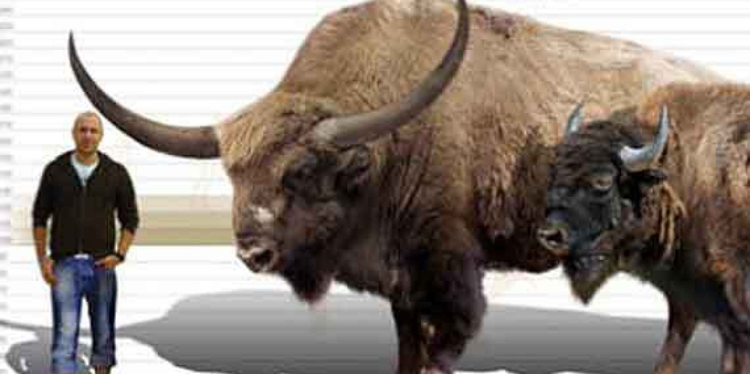
Bison Antiqus Extinct for 10-11K years

Slide 5
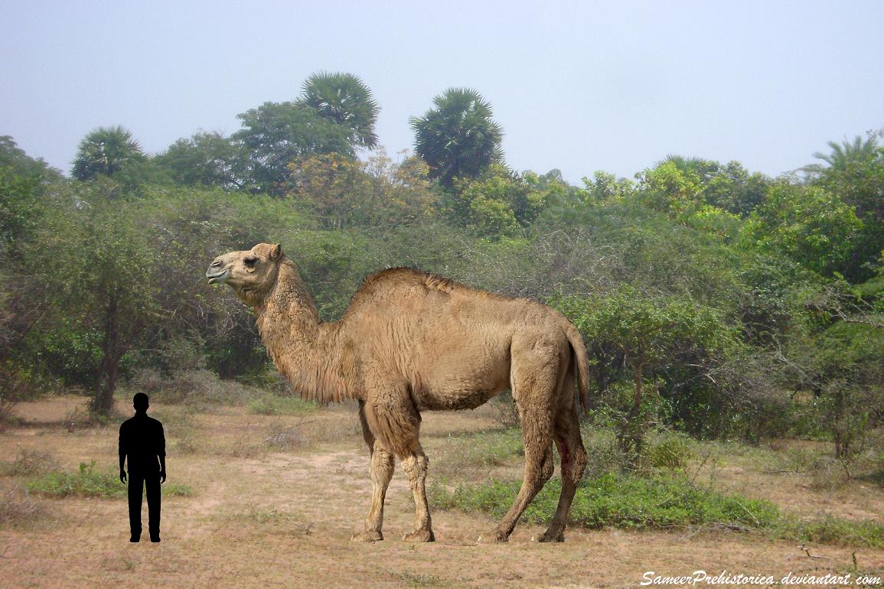
North American Camel – Extinct for 13K Years

Slide 6
Ground Sloth Extinct for 11K Years

Slide 7
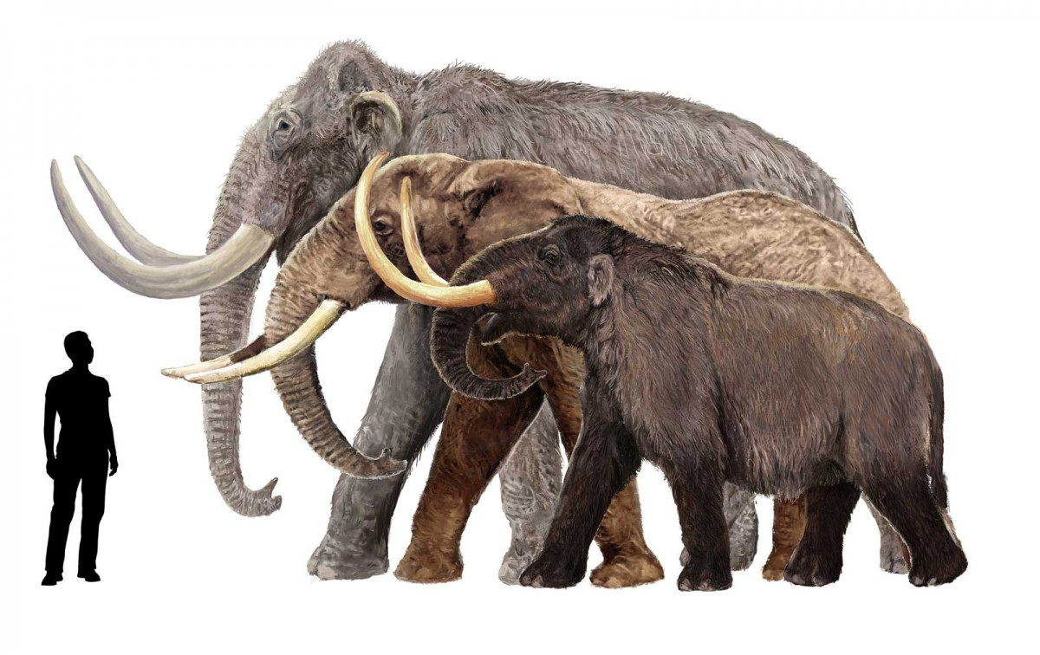
Mastodons/Mammoths Extinct for 10-11K years

Slide 8
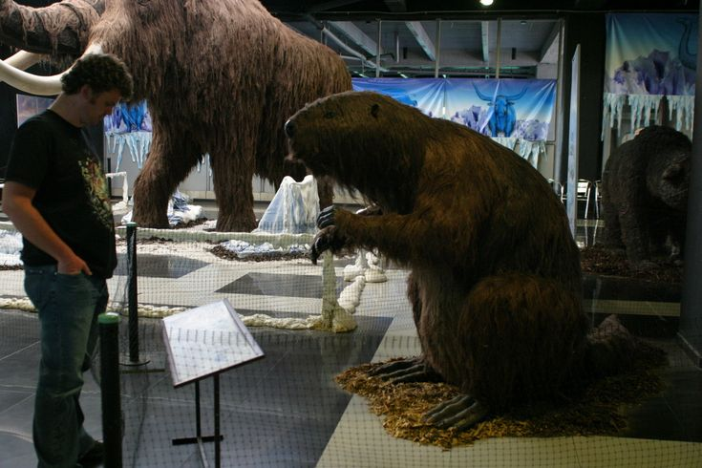
Giant Beaver Extinct for 10-13K Years

Slide 9
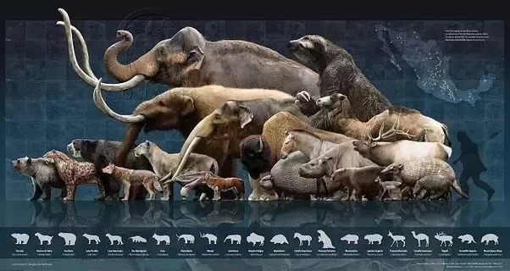
Early North America was Lit!

Slide 10
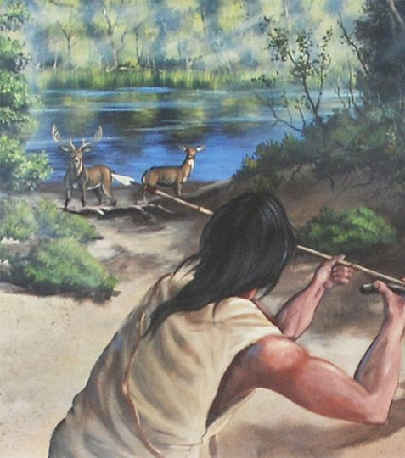
But this Guy Killed them All?
Really?

Slide 11
Or May Be Something Terrible Happened?

Slide 12
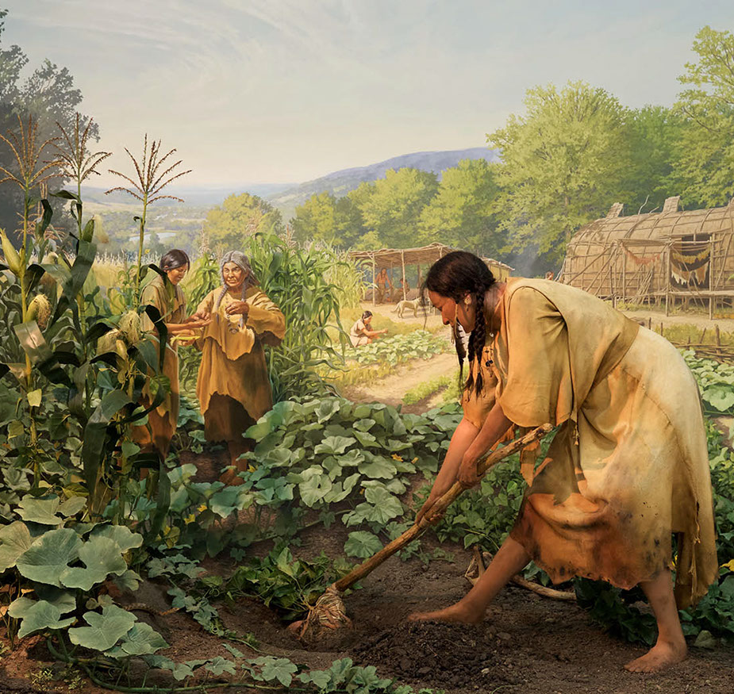
What About Farming?
Corn has been cultivated about 7300 years – link
Potato may go back 10K years but only in native range – link
Amaranth is about 6K years old in cultivation – link
Beans go about 7-10K years back in cultivation – link
Squash goes back about 8K years first domestication about 4K - link

Slide 13
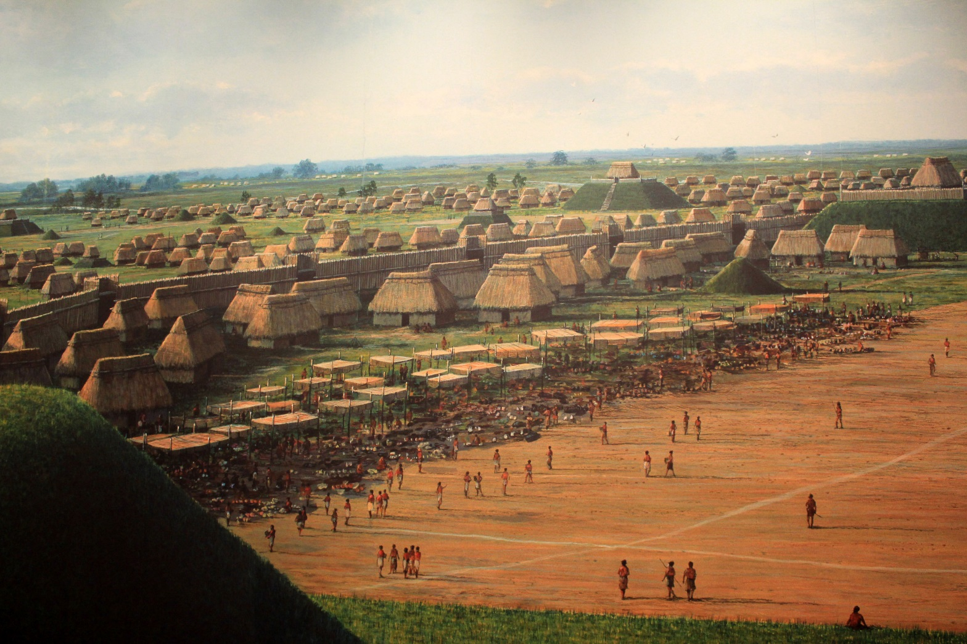
Then Something Else Terrible Happened – Civilization.

Slide 14
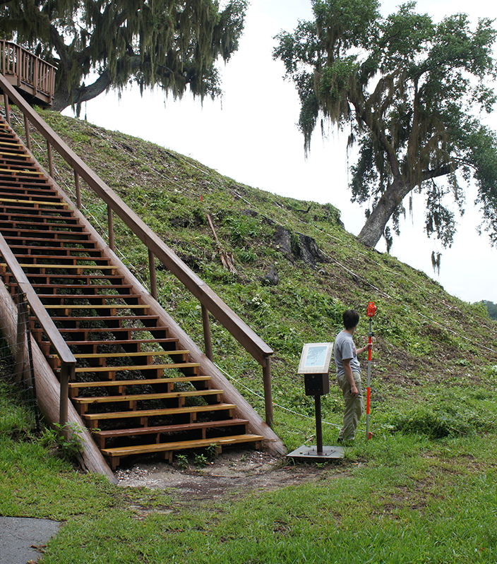
Still Animals were a Core Part of the Diet
Native Americans hunted deer, antelope, bison, elk, moose, sheep, squirrel, caribou, alligators, snakes, pretty much anything that walked/crawled, but none into extinction.
Most tribes/nations lived on major water ways and fish and shellfish were huge parts of their diets.
Most ag crops were well suited to long term storage.
Recommended Reading, “Guts and Grease” By Dr. Michael Eades – Link
Source of Image - Link

Slide 15
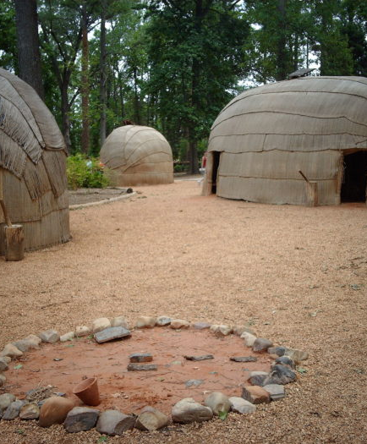
The Health of Native Americans
Evidence shows “health was in decline before Columbus” – link
Rise in agriculture
High density living
Yet by the 17-1800s Native Americans were Taller and Healthier than Colonists?
Something terrible happened again – smallpox

Slide 16
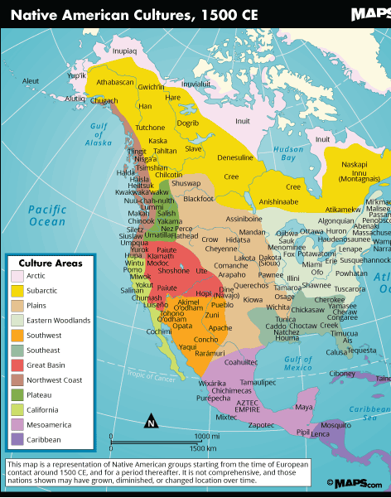
A Lot Gets Lost When We Make Everyone One Group

Slide 17
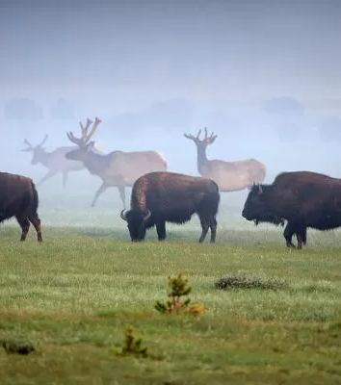
What Do We Take Away from This
Native North Americans ate mostly meat for most of their time here
Agriculture led to monarchies and tyranny just as they did everywhere else
Plant based diets and cities led to health problems regardless of why they happened
Catastrophes cause “great resets” that led back to meat & perennial based diets

